Slide 1

Late Game Strategy in NFL Football
Analysis of competing strategies

Slide 2

The Problem
Down by two possessions
  TD
  FG
Does order matter?
Does there come a point in an NFL game where a team prefers to drive for a fieldgoal as opposed to driving for a touchdown?

Slide 3
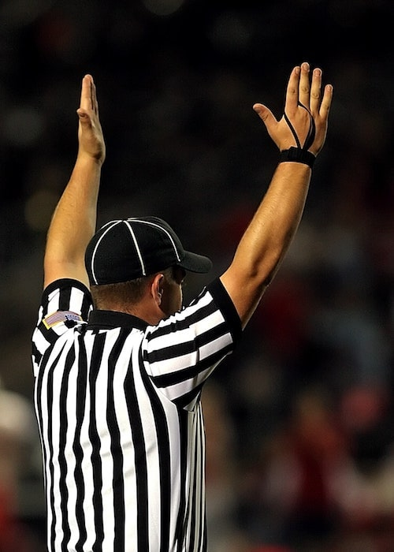
Touchdown First (TDF)
Intuition
  Positives
    Second drive requires only a fieldgoal
    More natural
  Negatives
    Takes a lot of time
    Difficult
This Photo by Unknown Author is licensed under CC BY-NC

Slide 4
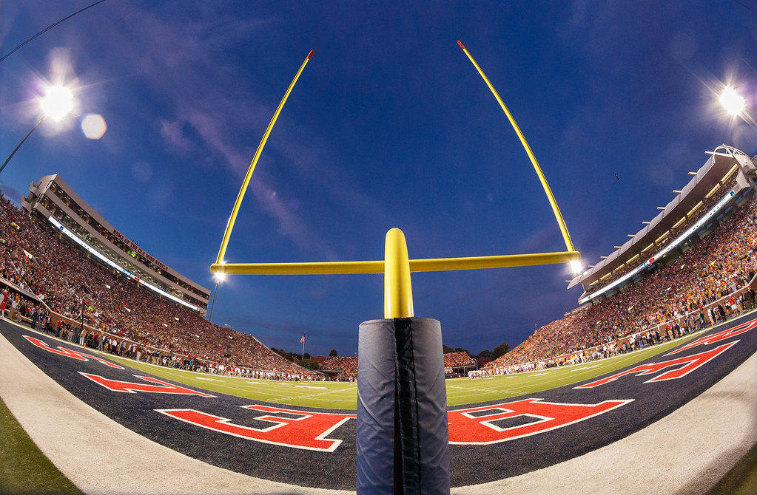
Fieldgoal First (FGF)
Intuition
  Positives
    Takes less time
    Relatively easier
  Negatives
    Second drive is longer
    Goes against traditional football goals

Slide 5
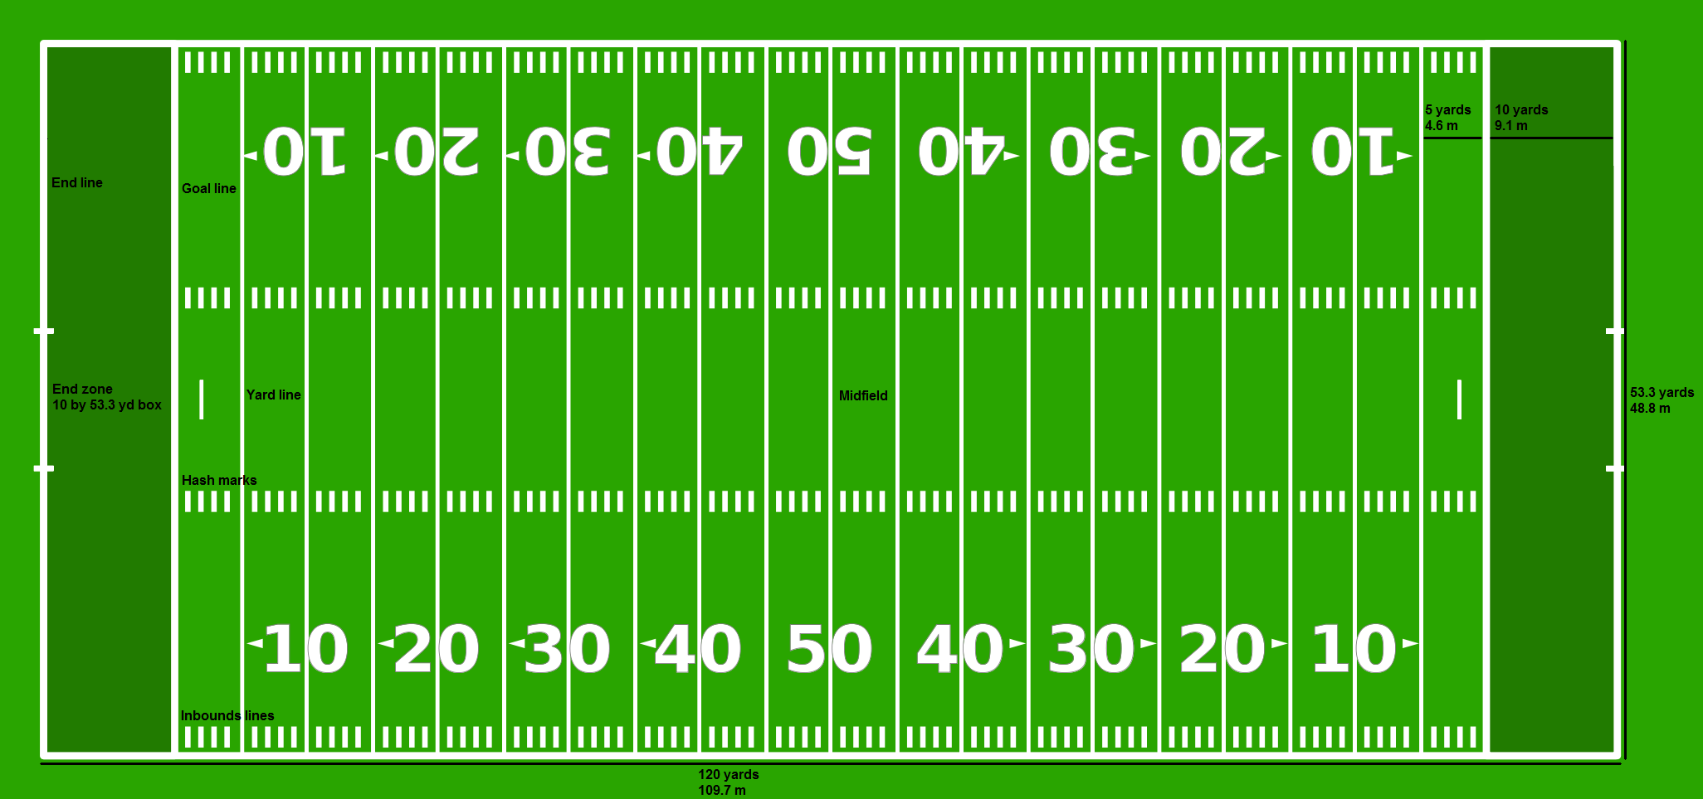
Problem Specified
9-11 points down
2 minutes remaining
1st and 10 on the 50
This Photo by Unknown Author is licensed under CC BY-SA

Slide 6
Analysis I- NFL Data
NFL Fast R
  Assumptions
  Drive selector simulation:
    First drive simulation A- Restricted
    First drive simulation B- non-restricted
    Second drive simulation TDF
    Second drive simulation FGF
Proof of Concept

Slide 7
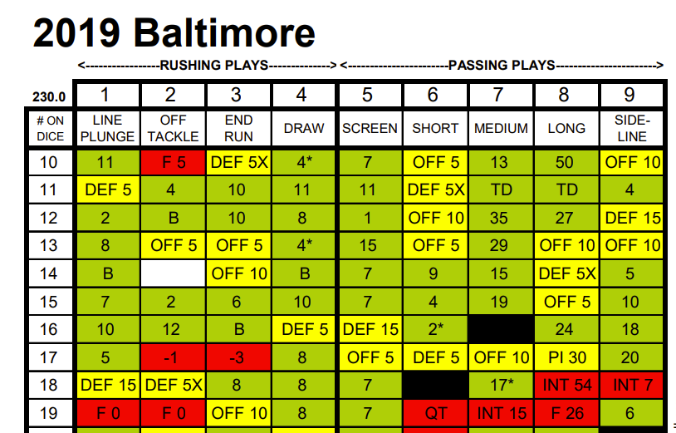
Data Driven Football
Playing cards
Simulation environment

Slide 8
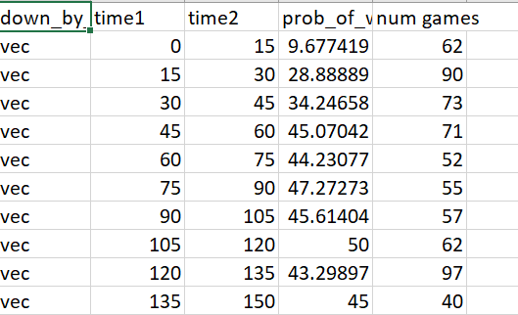
Analysis II- Integrated Approach
Simulation assumptions
First Drive:
  Goal yards
Second Drive:
  Probability levels
Notes:
Between 50 and 60 yardline

Slide 9
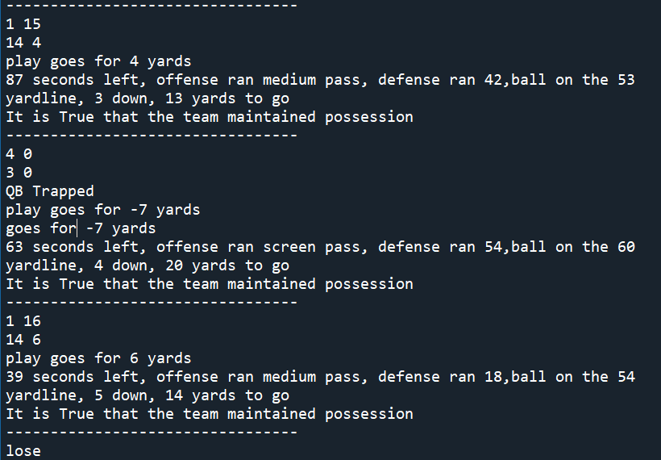
Analysis III- Simulation
Both drives simulated
Playing cards relied on
Comparison to actual outcomes

Slide 10
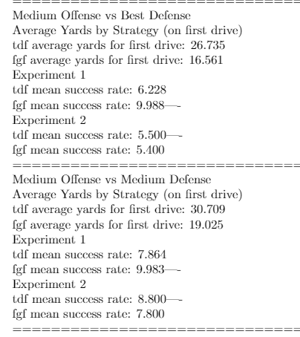
Results
A 1: (9.3, 16.38),
expanded: (9.9, 16.67)
A 2: FGF almost always slightly superior
A 3: TDF almost always slightly superior

Slide 11
Future Direction
Expand scope of analysis
Determine a function

Slide 12
Goal
Determine an optimal strategy given specific information

